Slide 1
Regular Expressions
Full Stack Web Developer Course

Slide 2
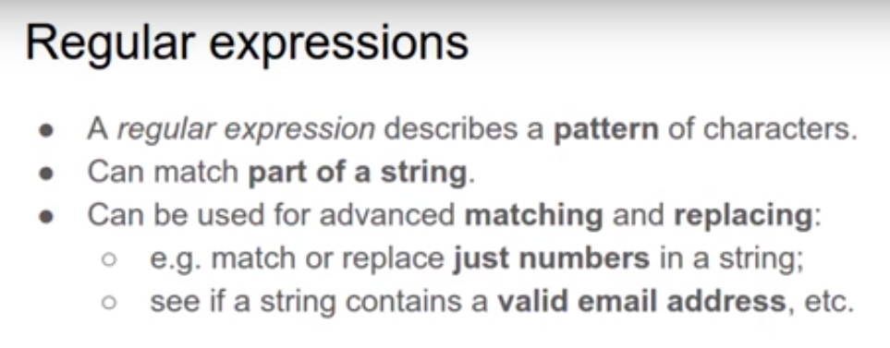
Introduction

Slide 3
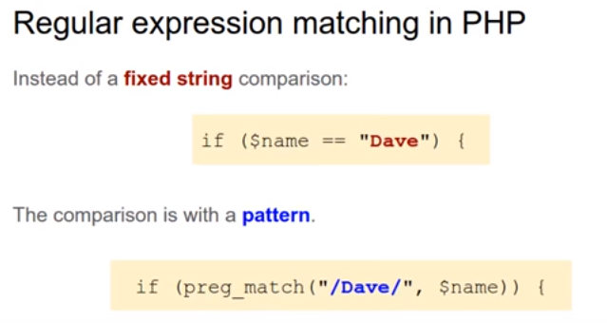
IF Condition & Regular Expressions:

Slide 4
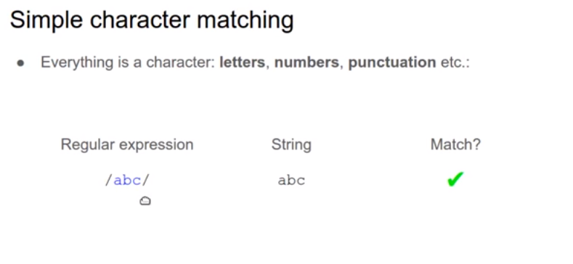
Simple Matching

Slide 5



EX. For simple matching
1)
2)
3)

Slide 6
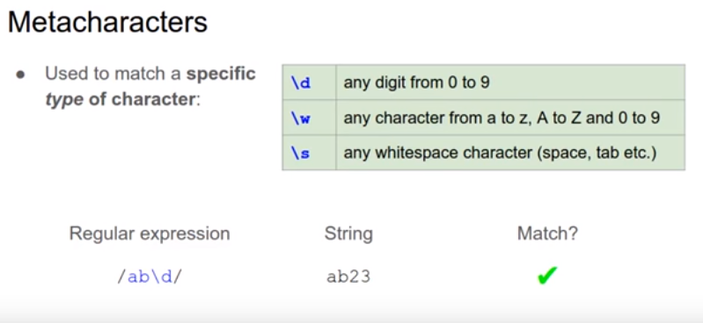
MetaCharacters

Slide 7



MetaCharacters examples:
1)
2)
3)

Slide 8
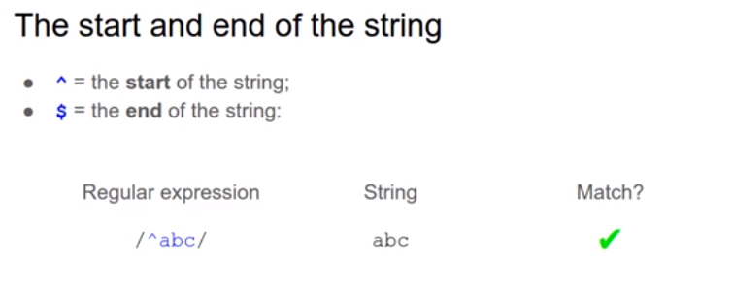
Start and End of the string

Slide 9



Examples for Start and End of the string:
1)
2)
3)

Slide 10


Cont. Examples for Start and End of the string:
4)
5)

Slide 11
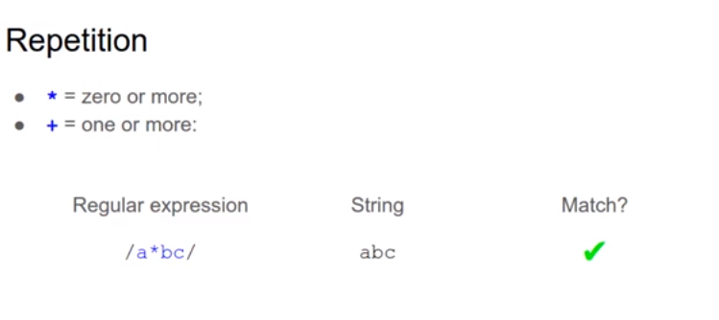
Repetition

Slide 12



Repetition Examples:
1)
2)
3)

Slide 13
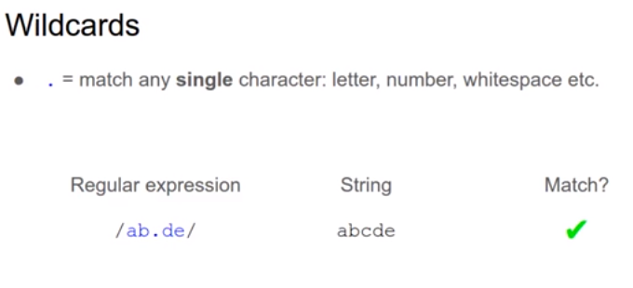
Wildcard

Slide 14



Wildcard examples:
1)
2)
3)

Slide 15


Cont. Wildcard examples:
4)
5)

Slide 16
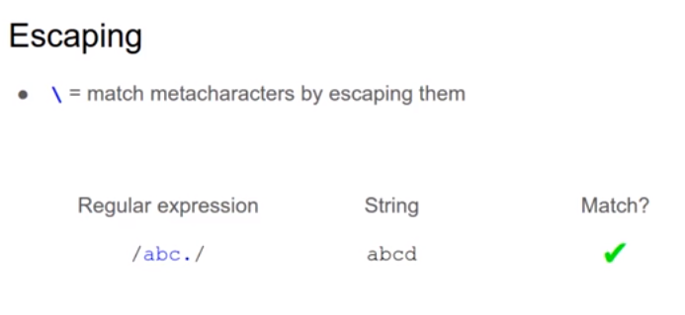
Escaping

Slide 17


Escaping examples:
1)
2)

Slide 18
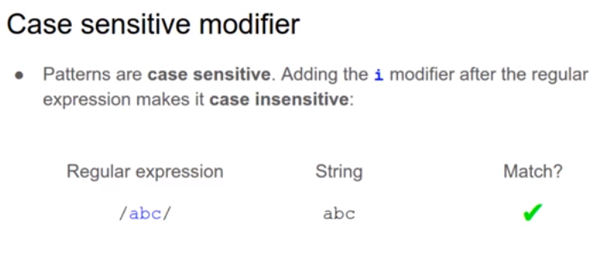
Case sensitive modifier

Slide 19


Case sensitive modifier examples:
1)
2)

Slide 20
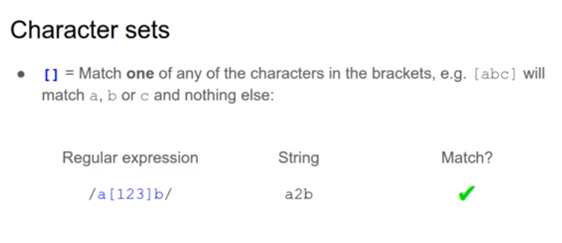
Character set

Slide 21



Character set examples:
1)
2)
3)

Slide 22
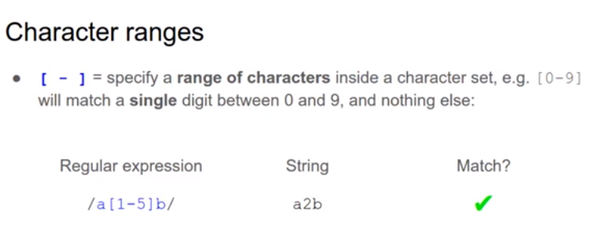
Character Range

Slide 23



Character Range examples :
1)
2)
3)

Slide 24
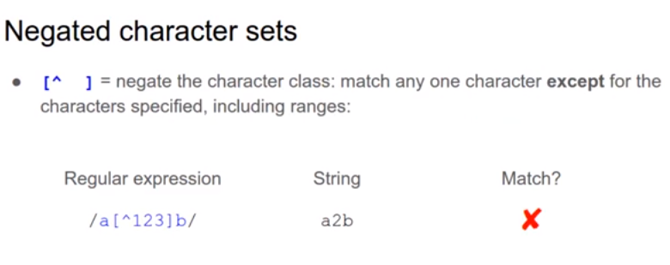
Negated Character set

Slide 25



Negated Character set examples:
1)
2)
3)

Slide 26
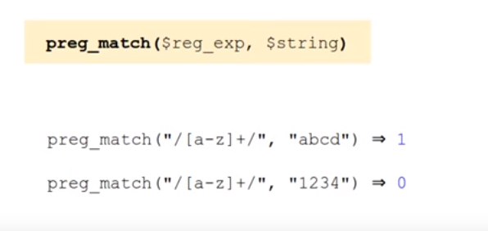
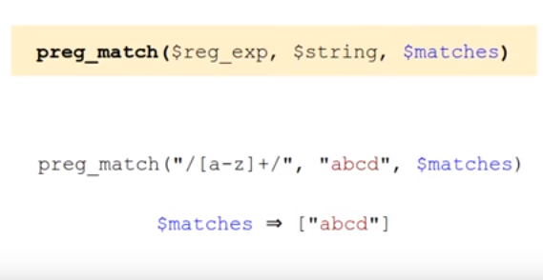
Preg_match()

Slide 27
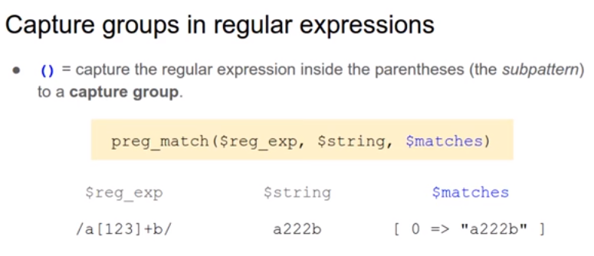
preg_match() 3 parameters Capture groups:

Slide 28


preg_match() 3 parameters Capture groups examples :
1)
2)

Slide 29
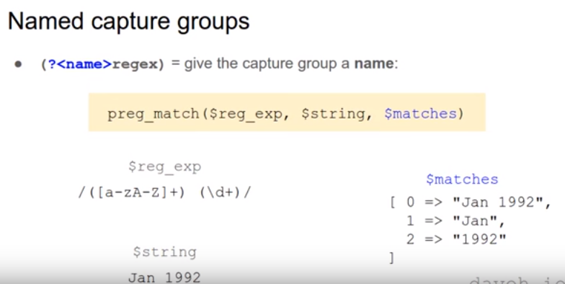
preg_match 3 parameters Named Capture groups

Slide 30

preg_match 3 parameters Named Capture groups example:

Slide 31
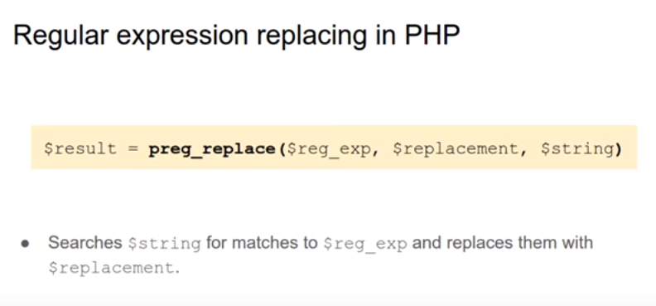
preg_replace()

Slide 32



preg_replace() examples:
1)
2)
3)

Slide 33
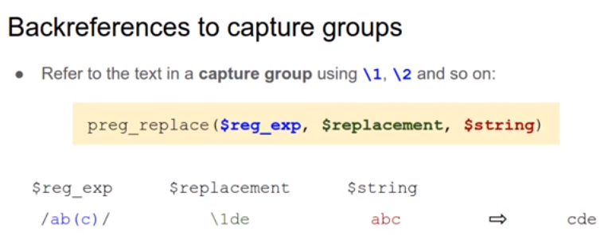
Backreferences to capture groups

Slide 34

Backreferences to capture groups example:

Slide 35
Questions ?

Slide 36
Thanks

